Slide 1
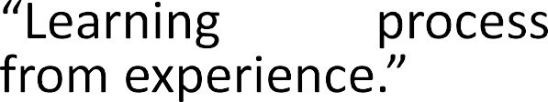










What is Machine Learning
- Herbert Simon
Machine Learning is the science (and art) of programming computers so they can learn from data. - Arthur Samuel, 1959
Definition by Tom Mitchell (1998):
Machine Learning is the study of algorithms that
.
A well-defined learning task is given by
Field of study that allows computers to learn without being explicitly programmed.

Slide 2

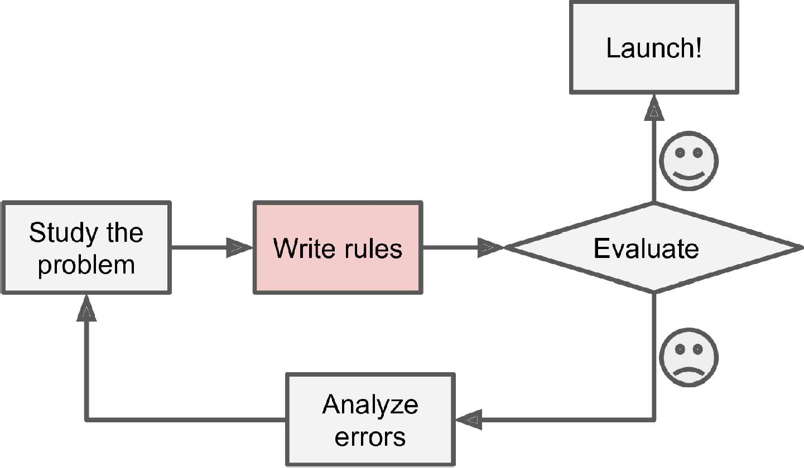
Traditional programming vs. Machine learning
One very practical way to think of machine learning is as a unique way of programming computers.
Most programming that is not machine learning is procedural essentially a set of rules defined by a human. This rule-set is called an algorithm.

Slide 3
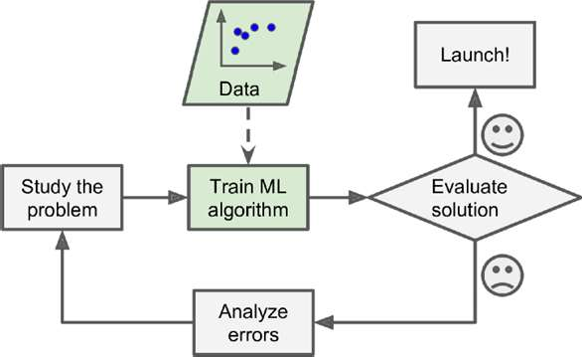
Traditional programming vs. Machine learning
ML algorithms learn from data, rather than direct human intervention, about the parameters that will shape a mathematical model for making predictions.

Slide 4
Machine Learning
Traditional computer programming
Machines can perform a set task using input data rather than relying on a direct input command.
where outputs or decisions are pre-defined by the programmer
Machine Learning
uses data as input to build a decision model.
Decisions are generated by deciphering relationships and patterns in the data using probabilistic reasoning, trial and error, and other computationally- intensive techniques.
This means that the output of the decision model is determined by the contents of the input data rather than any pre-set rules defined by a human programmer.

Slide 5
Example: Traditional Computer Programming vs. Machine Learning
Traditional Computer Programming
Scenario: You want a program to classify emails as "spam" or "not spam."
Approach: The programmer explicitly defines rules to identify spam emails, such as:
If the email contains certain keywords (e.g., "win," "free," "urgent"), classify it as spam.
If the sender is in the user's contact list, classify it as not spam.
The rules are manually coded and do not adapt unless the programmer updates them.
Outcome: The program strictly follows the rules defined by the programmer. If the rules miss certain patterns (e.g., new spam tactics), the system fails to classify accurately.

Slide 6
Machine Learning
Scenario: You want the system to classify emails as "spam" or "not spam."
Approach: The system is trained using labeled data (emails marked as spam or not spam). A machine learning model is built by:
Identifying patterns in the data, such as word frequency, email structure, and metadata.
Using algorithms like logistic regression, decision trees, or neural networks to learn decision boundaries.
Outcome: The system adapts to new data and updates its model based on the relationships and patterns discovered. It can generalize to identify spam emails, even if they use tactics not explicitly covered in the training data

Slide 7
Machine Learning
Role of programmer in ML:
The human programmer is still responsible for feeding the data into the model,
selecting an appropriate algorithm and
tweaking its settings (called hyperparameters) in order to reduce prediction error.

Slide 8
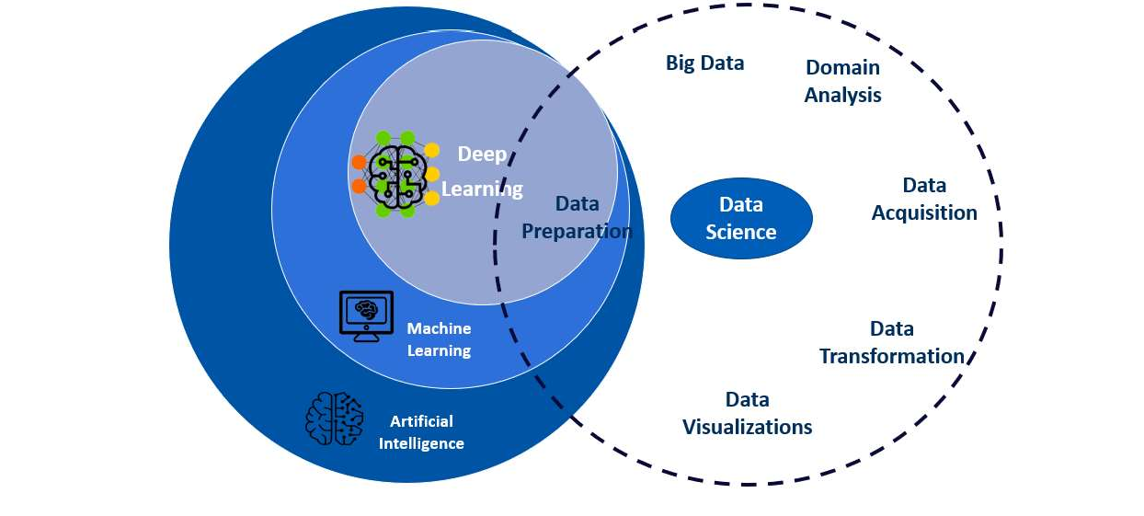
Machine Learning

Slide 9
Machine Learning
Use of Machine Learning:
Problems for which existing solutions require a lot of fine-tuning or long lists of rules: one Machine Learning algorithm can often simplify code and perform better than the traditional approach.
Complex problems for which using a traditional approach yields no good solution: the best Machine Learning techniques can perhaps find a solution.
Fluctuating environments: a Machine Learning system can adapt to new data.
Getting insights about complex problems and large amounts of data.

Slide 10
Applications of ML
Image Processing: face detection
Speech Recognition
Google Assistant, Siri, Cortana, and Alexa Self-driving cars
Email Spam and Malware Filtering
Creating a chatbot or a personal assistant
Fraud Detection
Stock Market trading
prediction of stock market trends
Medical Diagnosis: Detecting tumors in brain scans
NLP
Automatically classifying news articles

Slide 11
Machine Learning: Types
Machine Learning systems can be classified according to the amount and type of supervision they get during training.
Supervised Learning: Data and corresponding labels are given
Unsupervised Learning: Only data is given, and no labels are provided
Semi-supervised Learning: Some (if not all) labels are present
Reinforcement Learning: An agent interacting with the world makes observations, takes actions, and is rewarded or punished; it should learn to choose actions in such a way as to obtain a lot of rewards
Examples of usage: a self-driving car, or an AI program playing chess.

Slide 12
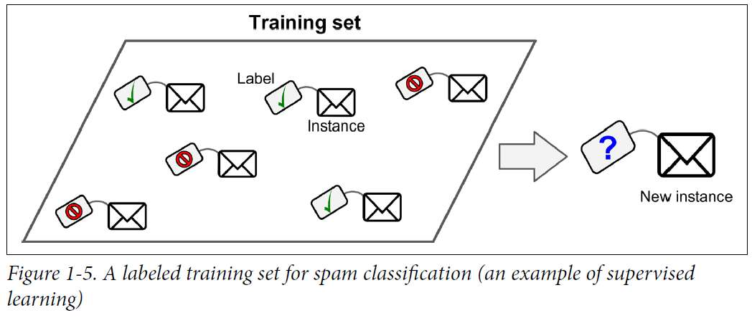
Supervised Learning
In supervised learning, the training set you feed to the algorithm
includes the desired solutions, called labels.

Slide 13
Classification
A typical supervised learning task is classification.
The spam filter is a good example classification: it is trained with many example emails along with their class (spam or not spam), and it must learn how to classify new emails.
k-Nearest Neighbors
Linear Regression
Logistic Regression
Support Vector Machines (SVMs)
Decision Trees and Random Forests
Neural networks

Slide 14
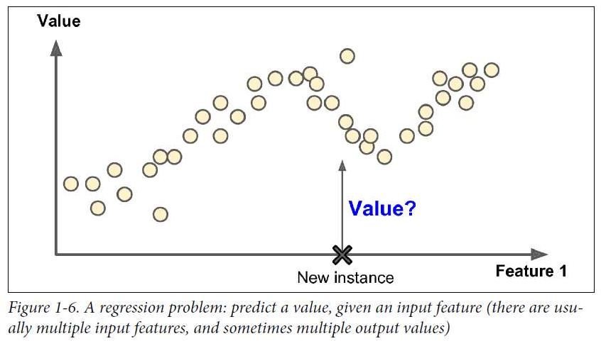
Regression
Another typical task is to predict a target numeric value, such as the price of a car, given a set of features (mileage, age, brand, etc.) called predictors.
This sort of task is called regression. To train the system, you need to give it many examples of cars, including both their predictors and their labels (i.e., their prices).

Slide 15
Unsupervised
In unsupervised learning, the training data is unlabeled. The system tries to learn without a teacher.
Clustering
K-Means
Hierarchical Cluster Analysis (HCA)
Anomaly detection
Visualization and dimensionality reduction
Principal Component Analysis (PCA)
Association rule mining
Market analysis , frequently bought items by customers

Slide 16
Semi supervised Learning
Since labeling data is usually time-consuming and costly, you will often have plenty of unlabeled instances, and few labeled instances. Some algorithms can deal with data that is partially
labeled.
This is called semi-supervised learning.
Some photo-hosting services, such as Google Photos, are good examples of this. Once you upload all your family photos to the service, it automatically recognizes that the same person.
Most semi supervised learning algorithms are combinations of unsupervised and supervised algorithms.

Slide 17
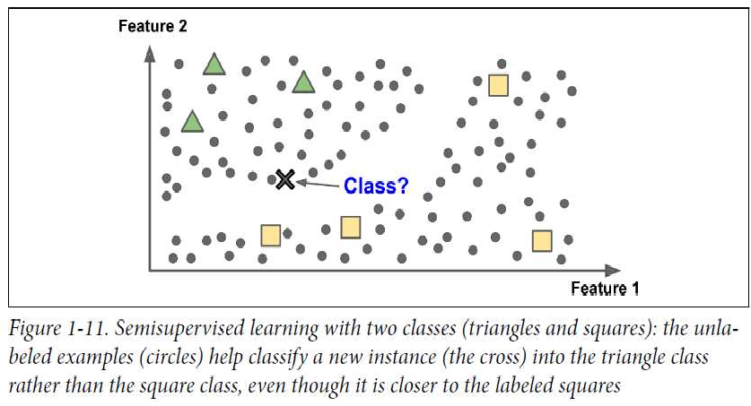
Semi supervised Learning

Slide 18
Reinforcement Learning
Reinforcement Learning is a very different beast. The learning system, called an agent in this context, can observe the environment, select and perform actions, and get rewards in return (or penalties in the form of negative rewards.
It must then learn by itself what is the best strategy, called a policy, to
get the most reward over time.
A policy defines what action the agent should choose when it is in a given situation.
For example, many robots implement Reinforcement Learning algorithms to learn how to walk.
DeepMind’s AlphaGo program is also a good example of Reinforcement Learning: it made the headlines in May 2017 when it beat the world champion Ke Jie at the game of Go.

Slide 19
Reinforcement Learning
Example: Teaching a Robot to Move in a Grid
Environment: A 5x5 grid with a goal in the bottom-right corner.
Agent: A robot starting in the top-left corner.
Actions: Move up, down, left, or right.
Rewards:
+10 for reaching the goal.
+1 or -1 for each right step or wrong step taken resply.
-5 for hitting a wall.
How the agent learns:
At first, it explores randomly and hits walls or wanders aimlessly.
Over time, it learns which paths lead to the goal and avoids inefficient routes.
Eventually, it discovers the shortest path to the goal.

Slide 20
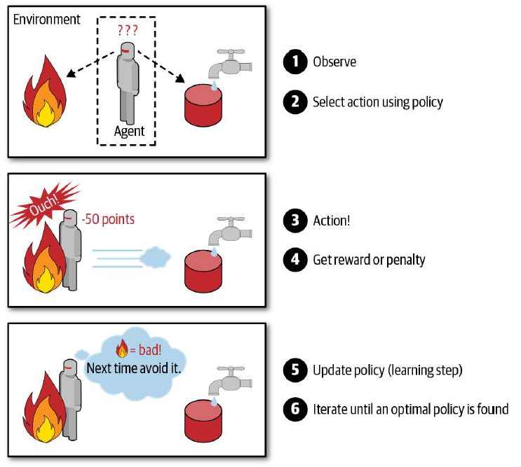
Reinforcement Learning

